Slide 1

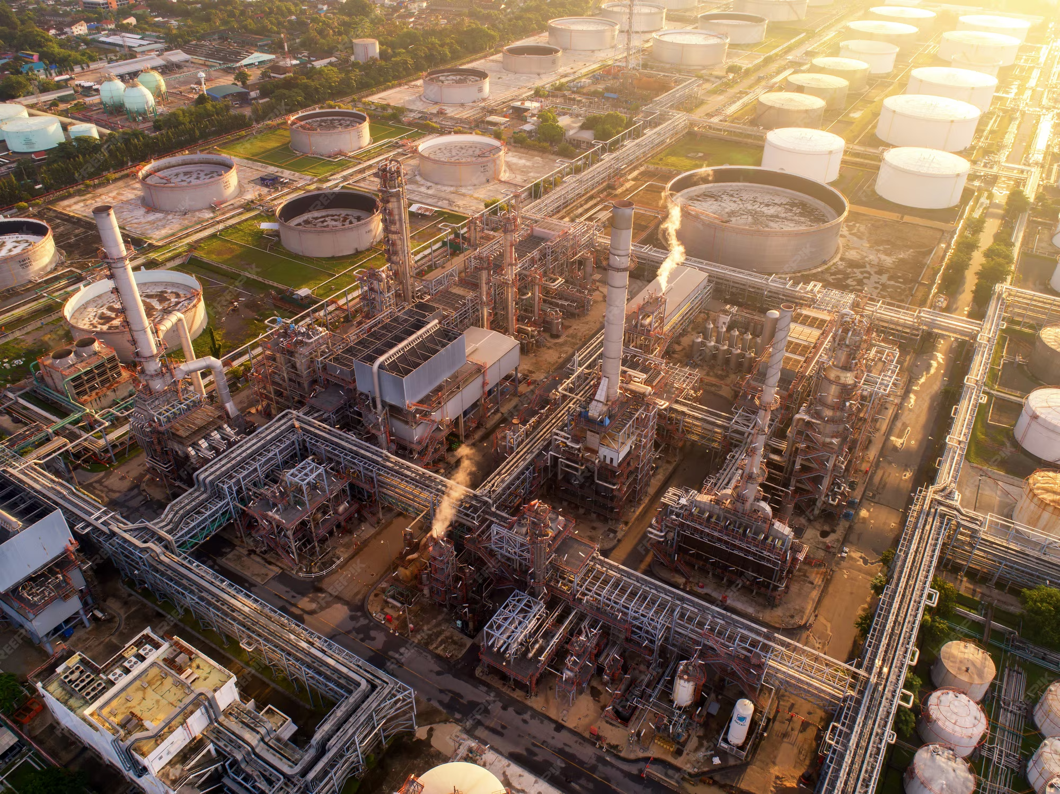

BRITISH COLUMBIA HYDRAULIC FRACTURING WATER USE ANALYSIS
Prepared By: Ivan Rugut
Data Analyst / GIS Analyst
Notes:
My objective with this analysis was to understand how hydraulic fracturing water use in British Columbia is distributed over time and across regions.
I will show how I cleaned and structured raw regulatory data so that water use could be measured accurately per fracture event, and mapped.

Slide 2
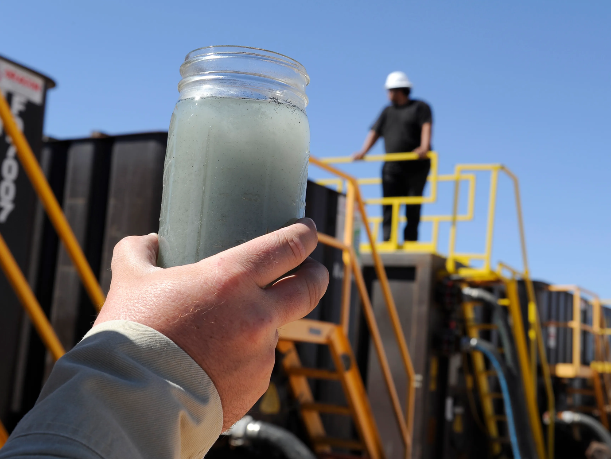

WHY THIS ANALYSIS MATTERS
01
Hydraulic fracturing is a water-intensive activity
02
Water use is regionally concentrated, not evenly distributed
03
Public regulatory data exists but is not analysis-ready
Goal: To turn raw regulatory data into clear insights and maps
Notes:
Hydraulic fracturing uses large volumes of water, but that use is not evenly spread across British Columbia. Most of the impact is concentrated in specific regions, which means local environmental pressure can be much higher than provincial averages suggest. Although public regulatory data exists, it isn’t structured in a way that allows for direct analysis.

Slide 3
OBJECTIVES
01
Quantify reported water use per fracture event
02
Identify temporal trends in water consumption
03
Compare water use across well areas
04
Visualize spatial concentration of high water-use activity
05
Demonstrate a reproducible
data cleaning → analysis → mapping workflow

Slide 4


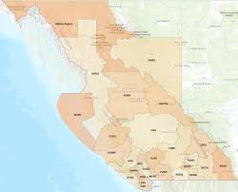
DATASETS USED
FracFocus – BIL-183 (BCER)
Ingredient-level hydraulic fracturing records
Includes water volumes, dates, and coordinates
BC Administrative Boundaries
Province of British Columbia — defined areas
Used for spatial context in ArcGIS Online
Esri Basemaps
Terrain / Oceans basemaps for geographic reference

Slide 5




DATA CHALLENGES
FracFocus data is reported at the ingredient level
Single fracture events appear across multiple rows
Why cleaning was required
Coordinates provided in DMS format
Direct analysis would overcount water use

Slide 6
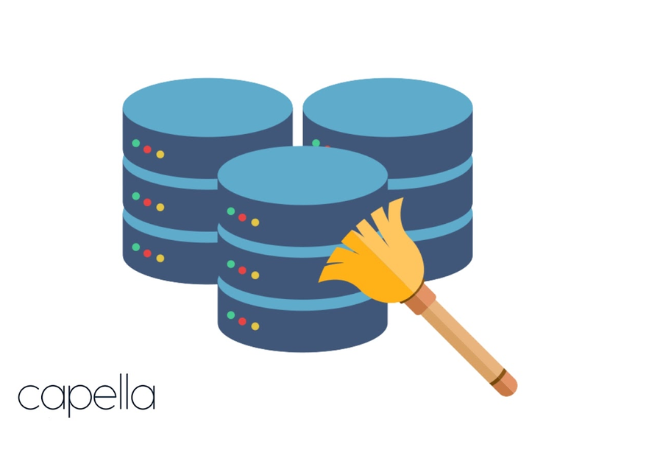






DATA CLEANING APPROACH
Loaded raw CSV using safe encoding
Standardized dates and numeric fields
Converted coordinates to decimal degrees
Removed incomplete or invalid records
Aggregated to one row per fracture event

Slide 7
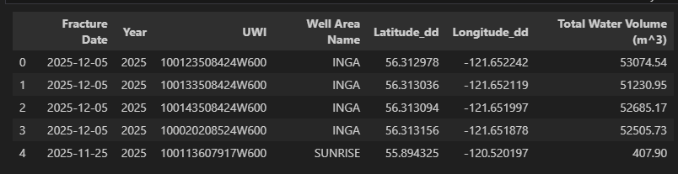
FINAL ANALYSIS DATASET
What the cleaned data represents
Each row = one hydraulic fracture event
~6,500 fracture events
Includes:
Date and year
Well area
Location (lat / lon)
Total water volume (m³)
No duplicate water counts

Slide 8

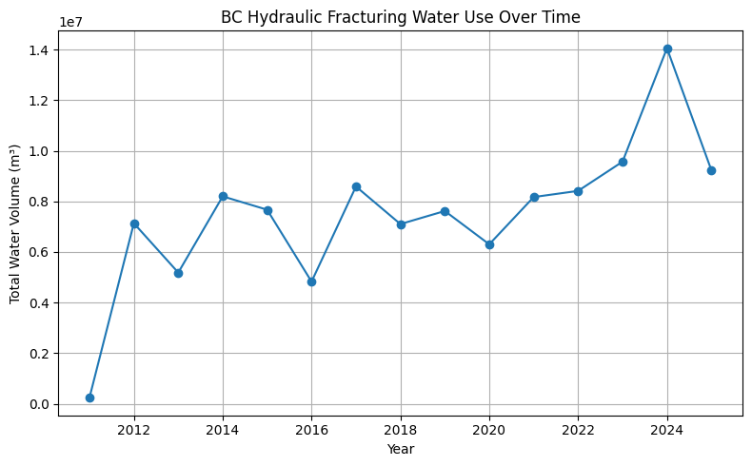
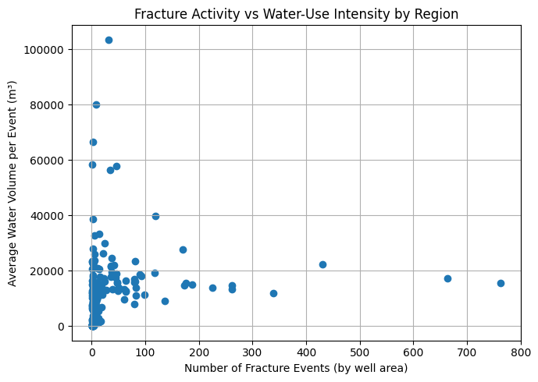
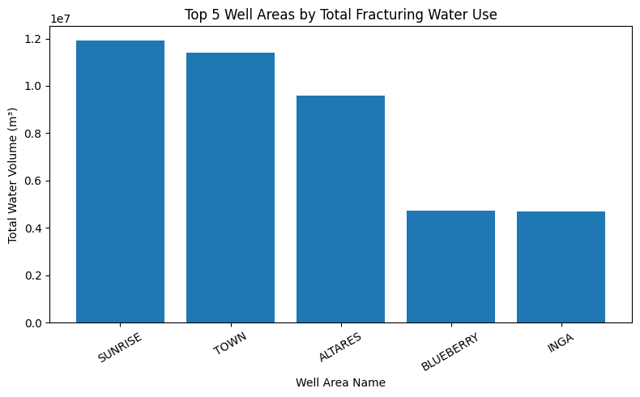
SUMMARY STATISTICS
KEY QUANTITATIVE FINDINGS
Notes:
Total fracturing water use generally increases over time, with noticeable year-to-year variability.Recent years show higher peaks, indicating larger or more water-intensive fracture operations rather than just more activity. A small number of well areas account for a disproportionate share of total water consumption.
This confirms that water demand is regionally concentrated, not evenly distributed across BC.
Regions with fewer fracture events can still have high average water use per event.
High total water use is driven by both frequency and intensity, not event count alone.
Water impact is shaped by where fracturing happens, how often it happens, and how water-intensive each event is.

Slide 9

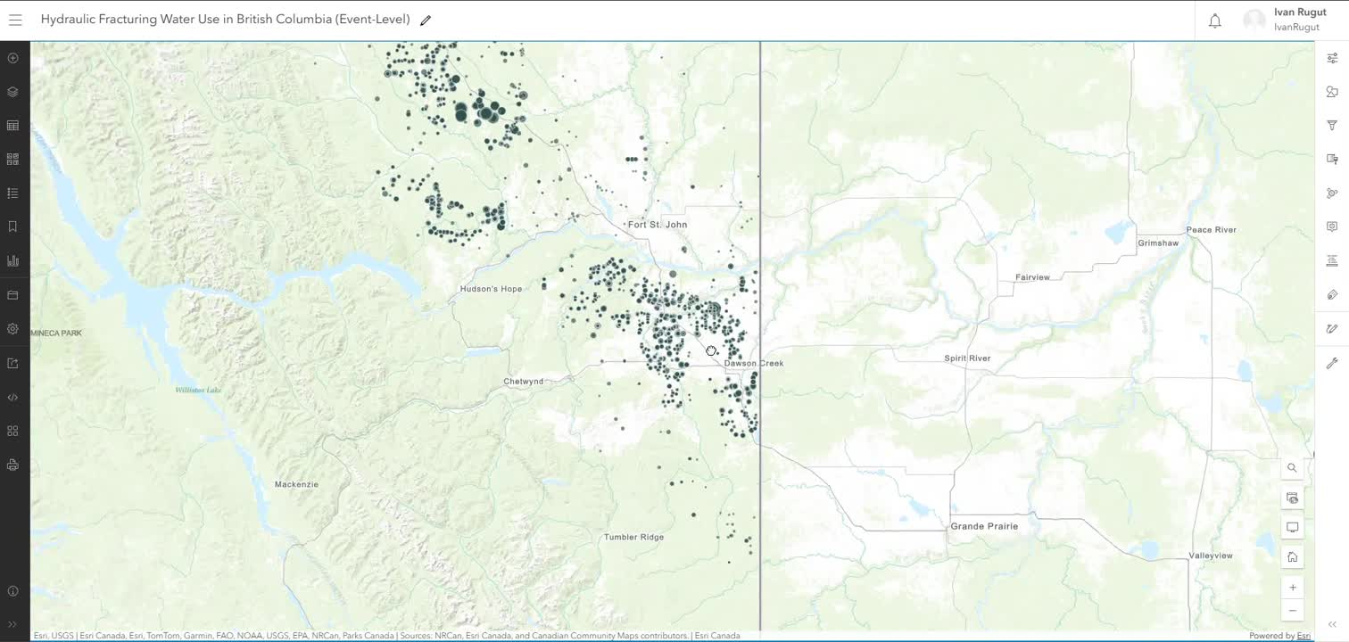
MAP 1: FRACTURE EVENTS (POINTS)

Slide 10
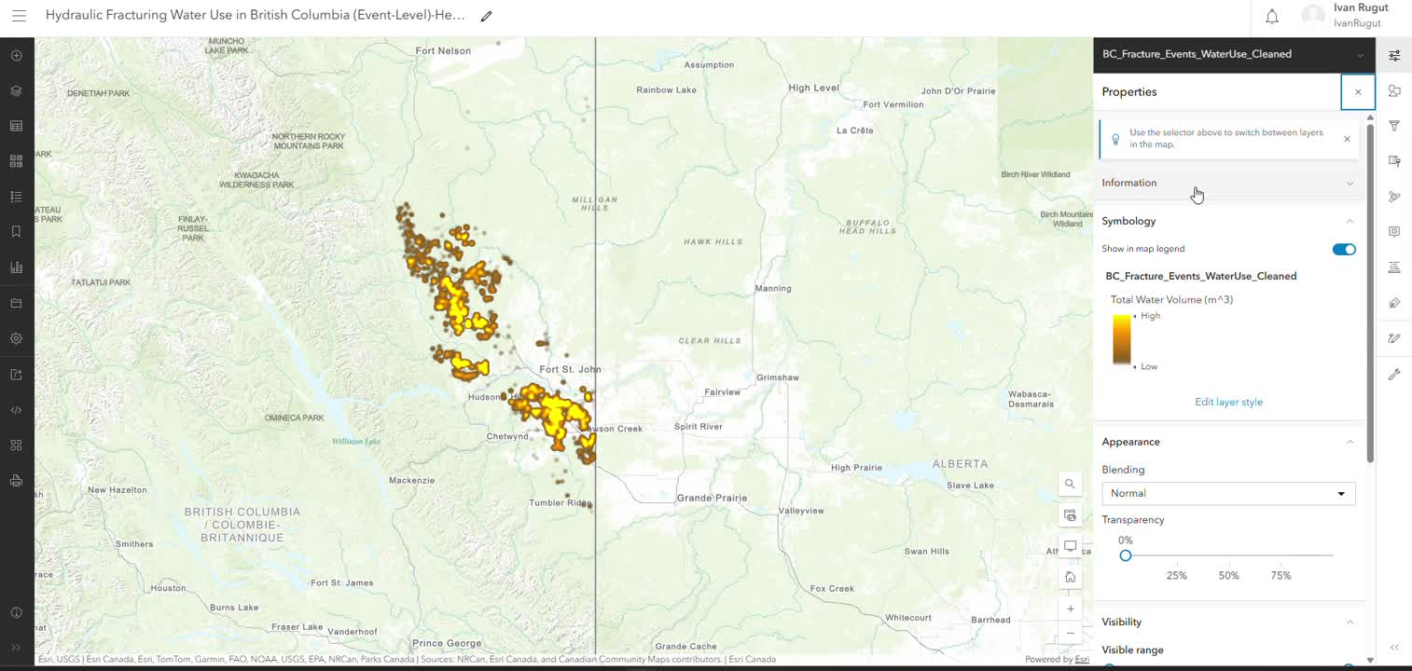
MAP 2: WATER USE HEATMAP

Slide 11

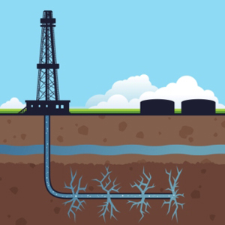
KEY TAKEAWAYS
WHAT STANDS OUT
1
Water use per fracture event is increasing
2
Total water demand is driven by a small number of regions
3
High-volume events contribute disproportionately

Slide 12
REFERENCES
Data and tools
British Columbia Energy Regulator (BCER)
BIL-183 – Complete FracFocus Data (BC)
FracFocus Chemical Disclosure Registry
Esri ArcGIS Online
Python: pandas, numpy, matplotlib
Jupyter Notebook

Slide 13
THANK YOU

